Slide 1
Data Analysis Training Workshop
Grand Palm Hotel, Gaborone
16-20 May 2022
Presentation by
Dr John Grewar
jdgrewar@gmail.com

Slide 2
Introduction

Slide 3
Workshop overview
Installing R and RStudio
GitHub and R in the cloud
Using R for
Calculator
Statistics
Data depiction with graphs and maps
Simulate data (Risk analysis)
Reporting using Rmarkdown
Other software – qGIS for clean maps

Slide 4
Workshop structure
Installing R and RStudio
GitHUB and working in the cloud
Introduction to R
General
Using functions
Apply functions
Basic statistics
Frequency measures
Measures of association
Spatial data analysis
RMarkdown and reporting from R
Diagnostic test analysis

Slide 5
Available files
Full folder of all code and data for analysis – but we will be using GitHub to access this but in case there are issues you can use this directly
Tutorial videos where applicable
Software
R
RStudio
Git for Windows
qGIS

Slide 6


1. Installing R and RStudio

Slide 7
R and RStudio can be installed from online at https://cloud.r-project.org/ and https://www.rstudio.com/products/rstudio/download/preview/ respectively but the software downloads are available in the software folder for the workshop - R-4.2.0-win.exe and RStudio-2022.02.1-461.exe respectively

Slide 8

2. GitHub and working in the cloud

Slide 9
Install GIT on your computer
software files: Git-2.36.0-64-bit
or https://git-for-windows.github.io/
Adjusting your PATH environment
SELECT Git from the command line and also from 3rd-party software
RStudio for Windows prefers for Git to be installed below C:/Program Files and this appears to be the default

Slide 10

Create a GitHub account and fork the workshop repository – www.github.com

Slide 11
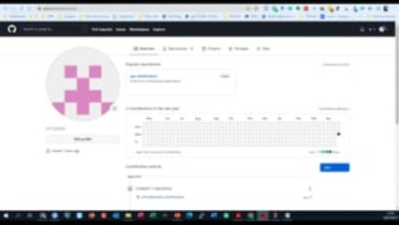
Create an authentication token

Slide 12
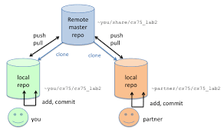
DEMO – add a file and push to GitHub

Slide 13
Theme 1: Introduction - R; Vectors, Matrixes, Factors, Lists , Dataframes, Functions

Slide 14

1.1 RStudio and making a project file
Open and Navigate RStudio
Open Project made in GitHub workflow
Open 01_Introduction.R
Check working directory

Slide 15
1.2 Introduction to R
Run through the 01_Introduction.R file

Slide 16

1.2 Introduction to R
Vector
Make vector of ages of attendees
Name them
Summary stats
Dataframe (l 188)
Create a dataframe based on the subset of wahid_species where the total number of cases are more than 10 AND the species is ‘Cattle’
Notes:
LINE 188: subset(wahid_species, totalNcase > 10 & spicieName == 'Cattle')

Slide 17
1.2 Introduction to R
Basic
1. create a vector of numbers of every even number between 2 and 20
2. establish the square root of the sum of your number vector
3. Create a vector of numbers between 1 and 50 (hint: use the : operator c(1:50))
4. Create a matrix
Intermediate
Use the sample function inbuilt in R to sample 10 numbers from the numbered vector in 3 above. hint: use the ?sample command to take a look at the sample function
Notes:
LINE 188: subset(wahid_species, totalNcase > 10 & spicieName == 'Cattle')

Slide 18
Commit and Push any changes or comments you have to your GitHub repository

Slide 19
Vectors (one dimensional array): can hold numeric, character or logical values.
All elements same data type
Matrices (two dimensional array): can hold numeric, character or logical values.
All elements same data type
Data frames (two-dimensional objects): can hold numeric, character or logical values.
Within each column the data-type is the same

Slide 20
1.2 Introduction to R
Basic
1. create a vector of numbers of every even number between 1 and 20
2. establish the square root of the sum of your number vector
3. Create a vector of numbers between 1 and 50 (hint: use the : operator c(1:50))
4. Create a matrix
Intermediate
Use the sample function inbuilt in R to sample 10 numbers from the numbered vector in 3 above. hint: use the ?sample command to take a look at the sample function
Notes:
LINE 188: subset(wahid_species, totalNcase > 10 & spicieName == 'Cattle')

Slide 21
1.4 Introduction to R
Apply functions
Open 01b_Apply.R

Slide 22
Theme 1: END

Slide 23
Theme 2: Basic statistics in R

Slide 24
Open 01_BasicStats.R

Slide 25
Commit and Push any changes or comments you have to your GitHub repository

Slide 26
Theme 2: END

Slide 27
Theme 3: Measures of Disease Frequency

Slide 28
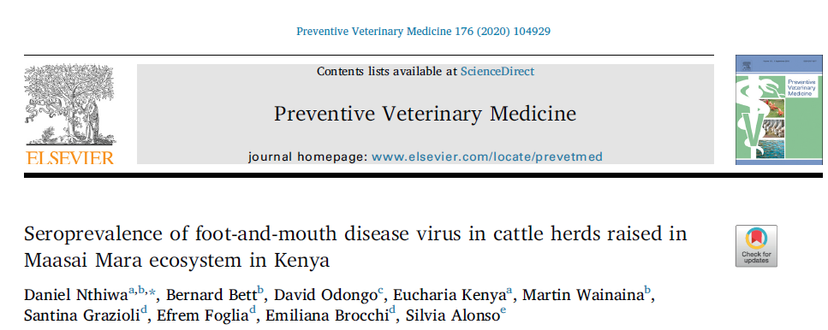
FMD sero-surveillance project in Masai Mara reserve in Kenya
Philosophy of data and code sharing

Slide 29
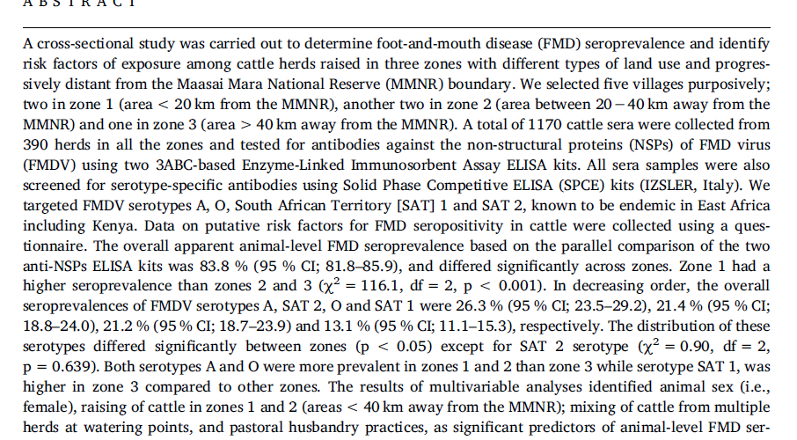

Slide 30
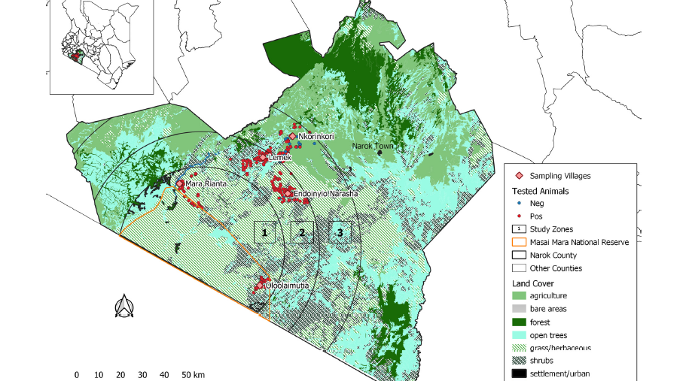

Slide 31
Open 03_Frequency.R

Slide 32
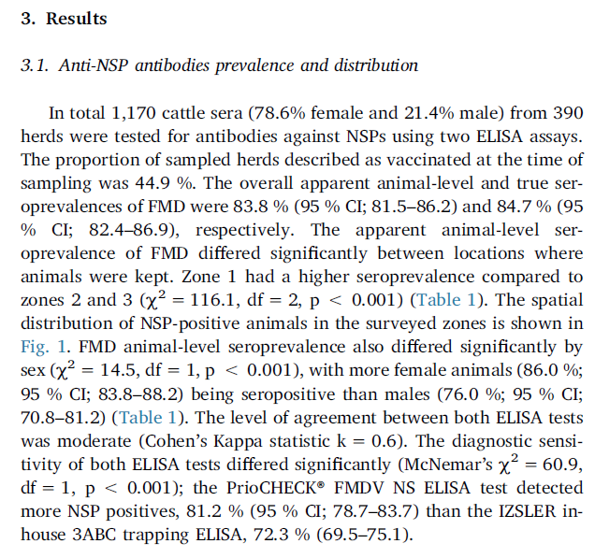
3.1 Results
Total tested
Sex proportions
Total herds tested
Apparent prevalence with confidence intervals

Slide 33
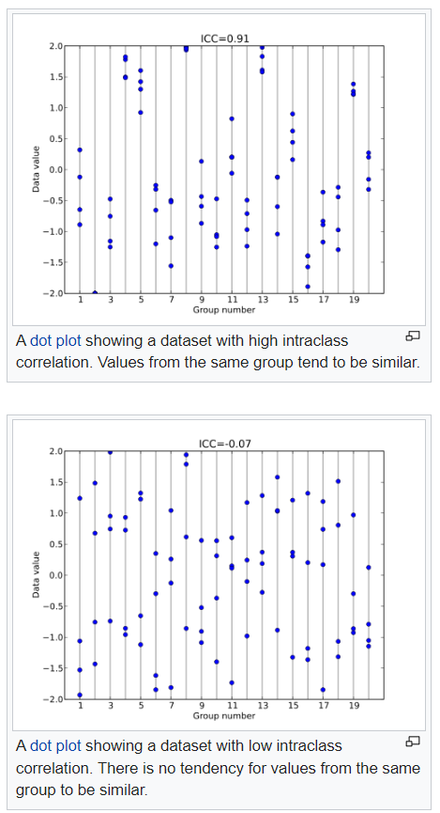
3.1.4 – Intraclass Correlation
How strongly do units/animals in the same groups resemble each other
[0,1]
0 = perfectly independent
1 = perfectly dependent
Consider diseases like FMD
Consider diseases like BSE
https://en.wikipedia.org/wiki/Intraclass_correlation

Slide 34
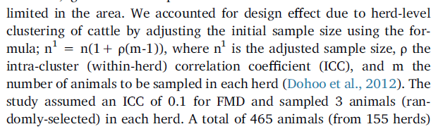
3.1.4 – Intraclass Correlation
Impacts sample size BECAUSE
Impacts outcome of prevalence survey
0.1 is pretty low – the outcomes of the study showed an ICC of 0.24
An increasing ICC (ρ) Rho will increase sample size
An increase sample size per herd will increase sample size
In this study the ability to sample so few animals per herd made the ICC impact small

Slide 35

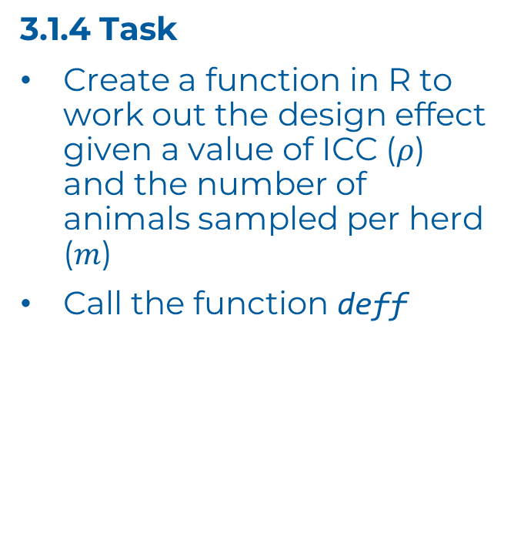
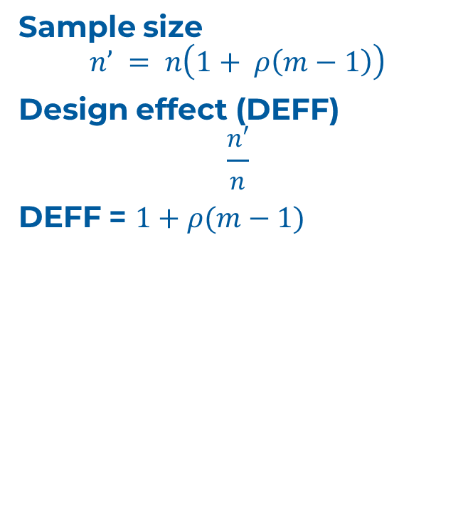

3.1.4 Task
Create a function in R to work out the design effect given a value of ICC ($ρ$) and the number of animals sampled per herd ($m$)
Call the function deff
Sample size
$$n’ = n\left(1+ ρ\left(m−1\right)\right)$$
Design effect (DEFF)
$$\frac{n′}{n}$$
DEFF = $1+ρ(m−1)$

Slide 36


Probability
0.95
0.5
On any given day what’s the probability of either happening? (i.e. Parallel)

Slide 37
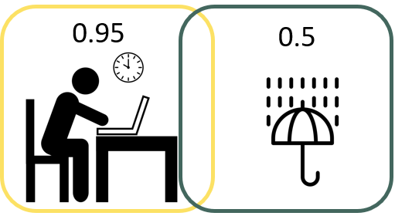
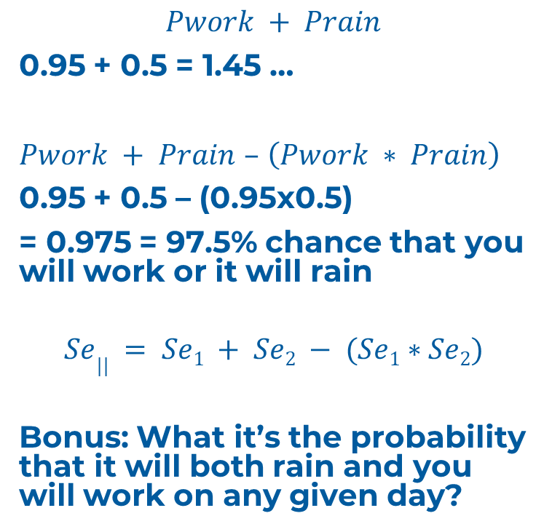
$$Pwork + Prain$$
0.95 + 0.5 = 1.45 …
$Pwork + Prain$ $–$ $\left(Pwork ∗ Prain\right)$
0.95 + 0.5 – (0.95x0.5)
= 0.975 = 97.5% chance that you will work or it will rain
$$Se|| = Se1 + Se2 − (Se1∗Se2)$$
Bonus: What it’s the probability that it will both rain and you will work on any given day?

Slide 38
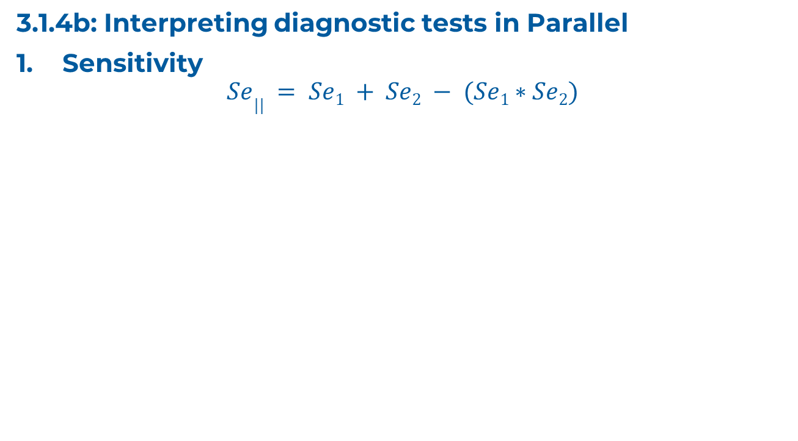
3.1.4b: Interpreting diagnostic tests in Parallel
Sensitivity
$$Se|| = Se1 + Se2 − (Se1∗Se2)$$

Slide 39
NEGATIVE SAMPLE
2. Specificity
Test 1
1-Sp
Sp
+
-
Test 2
+
-
+
-
1-Sp
Sp
1-Sp
Sp
+
+
+
-

Slide 40
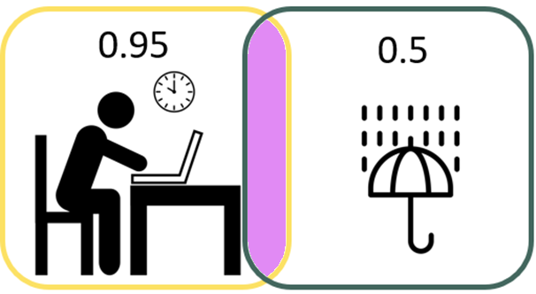
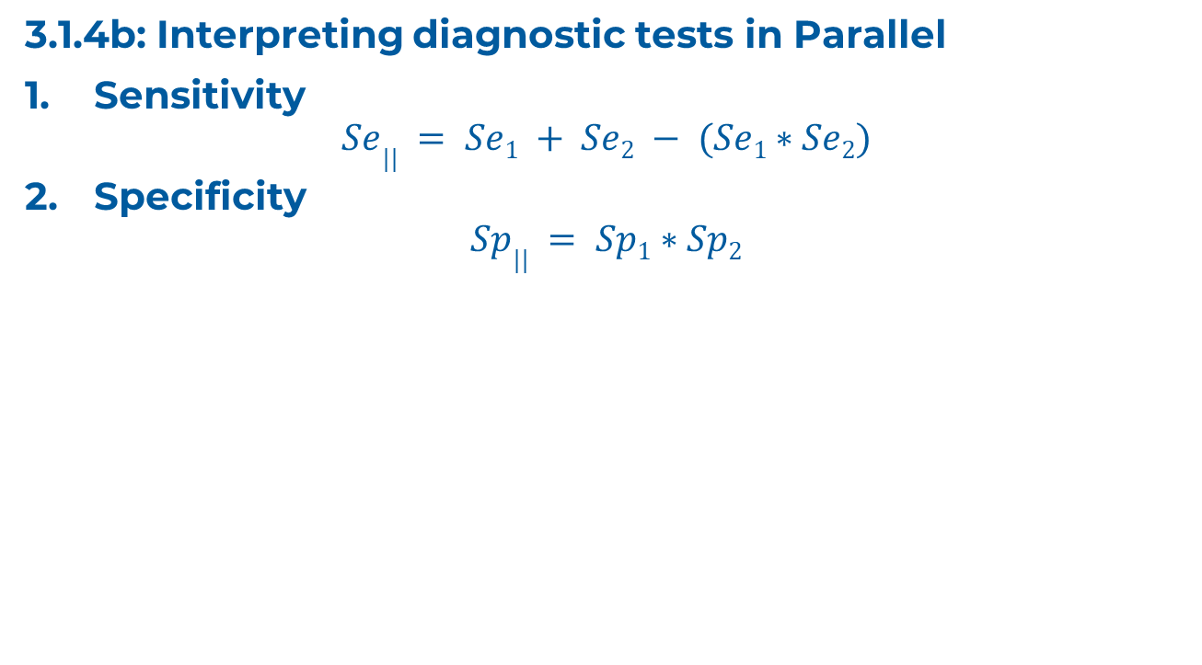
3.1.4b: Interpreting diagnostic tests in Parallel
Sensitivity
$$Se|| = Se1 + Se2 − (Se1∗Se2)$$
Specificity
$$Sp|| = Sp1∗Sp2$$
testing in parallel increases sensitivity
but decreases specificity

Slide 41
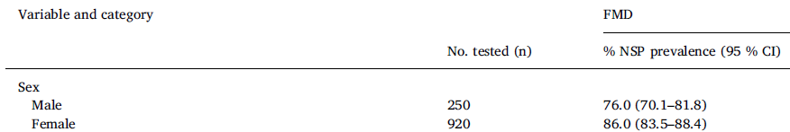
3.1.6 Task establish the sex proportions with their 95% confidence intervals

Slide 42
3.1.7 - Prevalence estimates - Botswana context
Goal - extract all foot-and-mouth disease data
Assume design effect of 1 (no clustering between sampled herds)
Plot these prevalence's using ggplot
Facet these graphs by species

Slide 43
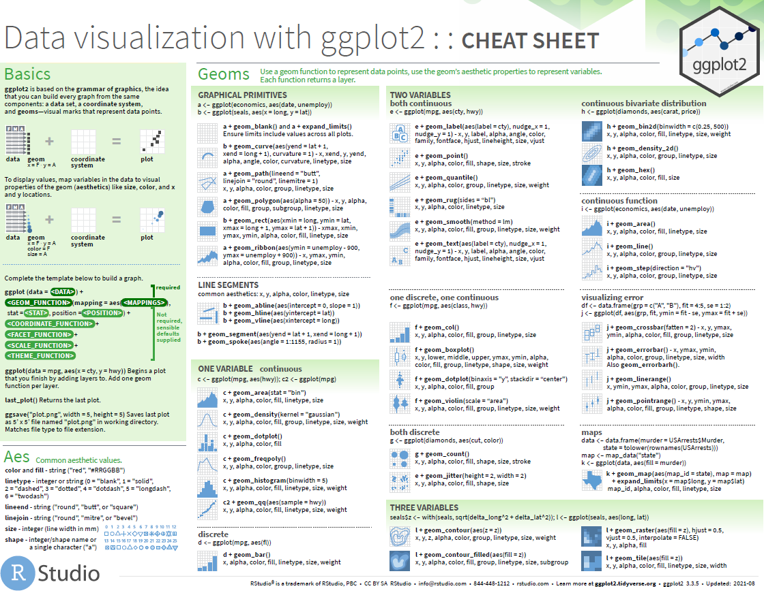
3.1.7.2

Slide 44
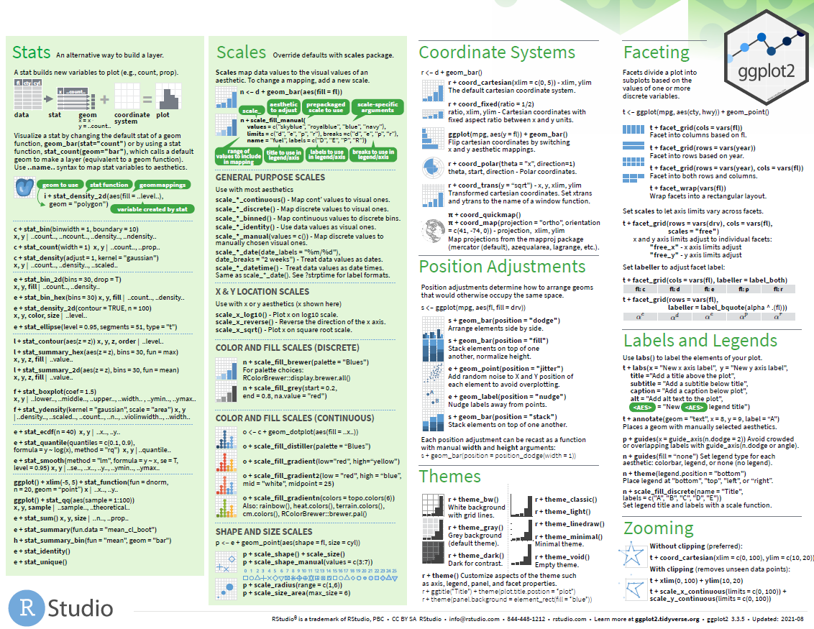

Slide 45
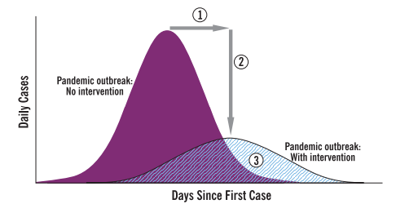
3.2 Frequency over time - epidemic curves
one of the most common, and important portrayals of animal (all) health data
CDC: https://stacks.cdc.gov/view/cdc/11425

Slide 46
Task: lets redo those Epidemic curve graphs but focusing on FMD - but do this without changing the underlying data, just use the ggplot language
Can you go one step further and just look at 2014 and 2015? – for this you might want to change the underlying data
Notes:
ggplot(wahid_outbreaks.epiCurve.plot %>% filter(diseases == "FMD"), aes(x=as.Date(yearmon), y=n, fill = diseases)) +
geom_bar(stat='identity') +
labs(x="Case Month", y="Case Count") +
theme_bw() +
scale_y_continuous(limits = c(0,max(wahid_outbreaks.epiCurve.plot$n*1.5)),
breaks = seq(0,max(wahid_outbreaks.epiCurve.plot$n*1.5),10)) +
scale_x_date(date_breaks = "1 month", date_labels = "%b %y",
name = "Date") +
theme(axis.text.x=element_text(angle=60, hjust=1),
panel.grid = element_blank())

Slide 47
Commit and Push any changes or comments you have to your GitHub repository

Slide 48
Theme 3: END

Slide 49
Theme 4: Measures of Association

Slide 50
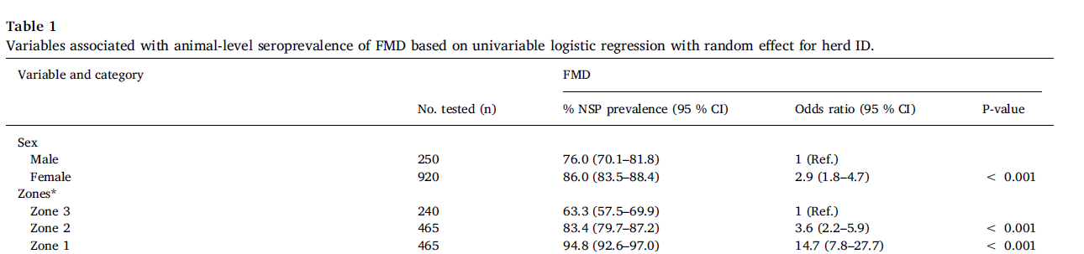

Slide 51
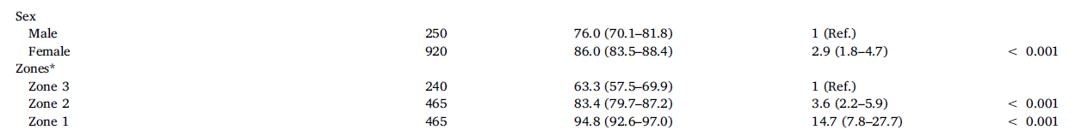
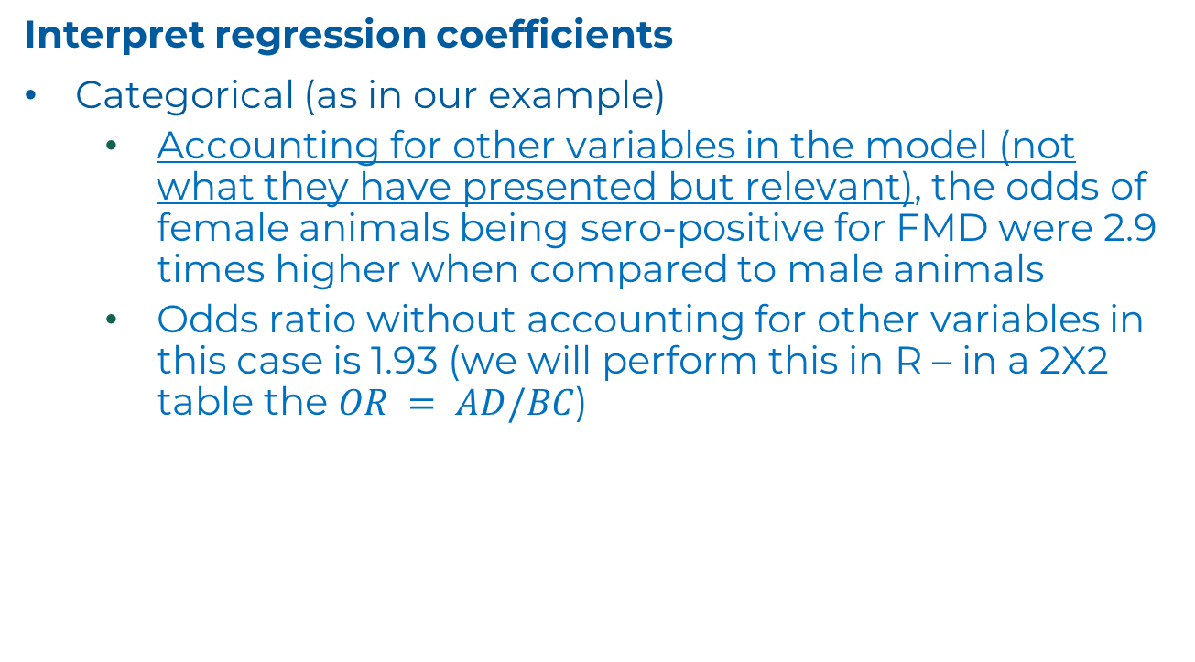
Interpret regression coefficients
Categorical (as in our example)
Accounting for other variables in the model (not what they have presented but relevant), the odds of female animals being sero-positive for FMD were 2.9 times higher when compared to male animals
Odds ratio without accounting for other variables in this case is 1.93 (we will perform this in R – in a 2X2 table the $OR = AD/BC$)

Slide 52
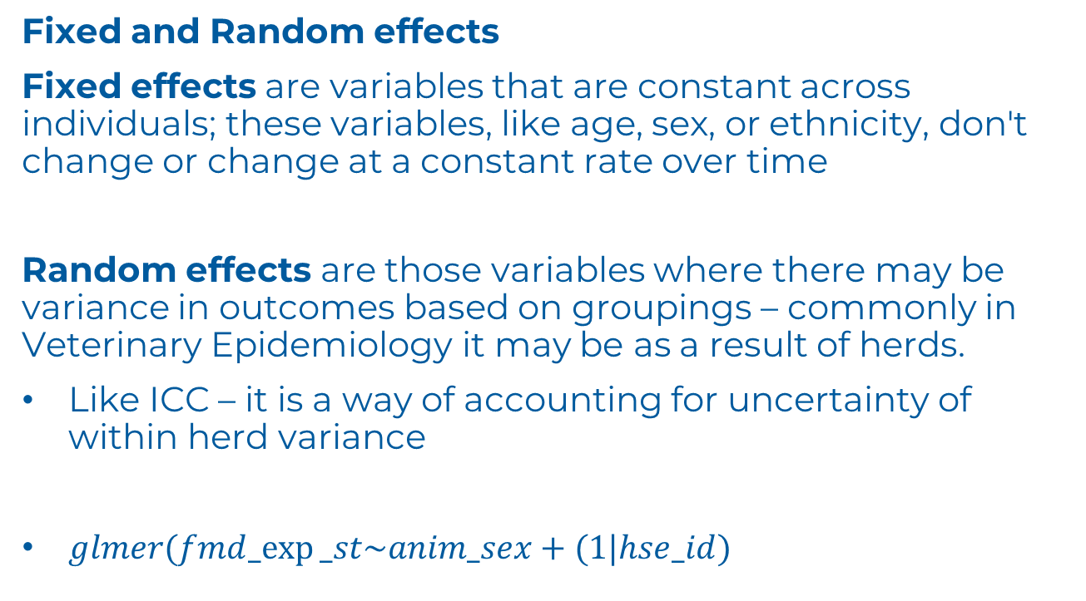
Fixed and Random effects
Fixed effects are variables that are constant across individuals; these variables, like age, sex, or ethnicity, don't change or change at a constant rate over time
Random effects are those variables where there may be variance in outcomes based on groupings – commonly in Veterinary Epidemiology it may be as a result of herds.
Like ICC – it is a way of accounting for uncertainty of within herd variance
$glmer(fmd_exp⁡_st\sim anim_sex+(1|hse_id)$

Slide 53
Open 04_MeasuresOfAssociation.R

Slide 54
epiR::epi.2by2
The order for the functionality defines the output
 | Disease + | Disease -
Exposure + (test +) | A | B | TOTAL Exposed
Exposure – (test -) | C | D | TOTAL Unexposed
 | TOTAL Diseased | TOTAL Free | TOTAL

Slide 55
4.2 Perform univariable logistic regression accounting for Herd as a Fixed effect for two of the other variables in the Nthiwa et al. dataset

Slide 56
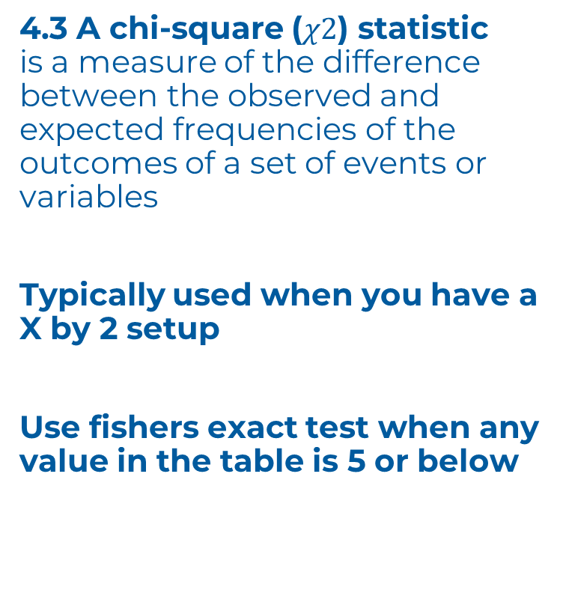
4.3 A chi-square ($χ2$) statistic is a measure of the difference between the observed and expected frequencies of the outcomes of a set of events or variables
Typically used when you have a X by 2 setup
Use fishers exact test when any value in the table is 5 or below

Slide 57
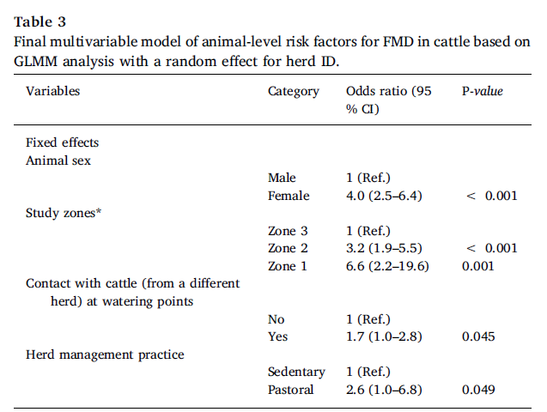
4.4 Multivariate analysis
Accounting for other variables in the data
Notice the impact on the sex variable – shows the impact that considering other variables has

Slide 58
Theme 4: END

Slide 59
Theme 5: Spatial Analysis

Slide 60
Replicating the analysis and plot in Nthiwa et al.
Difference will be the use of a Cattle density layer rather than land use

Slide 61
5.A Aside
1. importing tabular excel files
importTabularOnlineExcel<- function(
baseURL. = baseURL,
folder = "tabular",
filePlusExt = NULL
){
if (missing(filePlusExt)) {
stop("Please provide a vaild file to be sourced")
}
temp = tempfile()
download.file(paste0(baseURL., "/",folder,"/",filePlusExt), destfile=temp, mode='wb')
return(data.frame(readxl::read_excel(temp)))
unlink(temp)
}

Slide 62
importShapefilesOnline<- function(
baseURL. = baseURL,
folder = "gis/shapefiles",
filePlusExt = NULL
){
if (missing(filePlusExt)) {
stop("Please provide a vaild file to be sourced")
}
library(terra)
temp <- tempfile()
tempunzipped <- tempfile()
URL = paste0(baseURL.,"/", folder,"/", filePlusExt)
download.file(URL, temp)
unzip(zipfile = temp, exdir = tempunzipped)
return(vect(tempunzipped))
unlink(temp)
unlink(tempunzipped)
}
5.A Aside
2. importing shapefiles

Slide 63
5.1 Aside – Geographic Information Systems
Projected Coordinate Reference System (CRS) - UTM

Slide 64
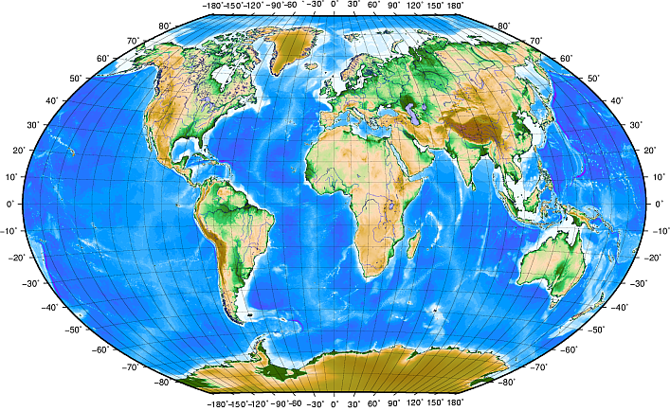
5.1 Aside – Geographic Information Systems
Geographic Coordinate Reference System (CRS) – WGS84

Slide 65
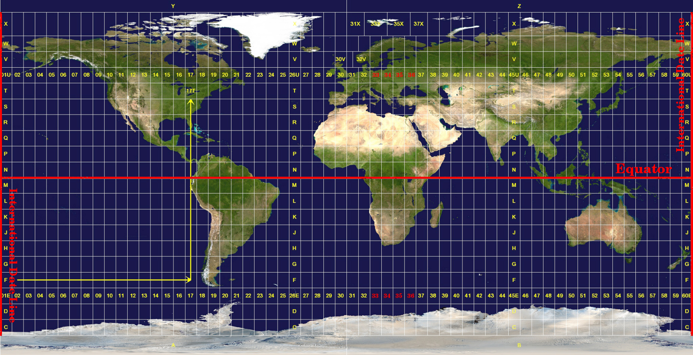
5.1 Aside – Geographic Information Systems
Projected Coordinate Reference System (CRS) - UTM

Slide 66
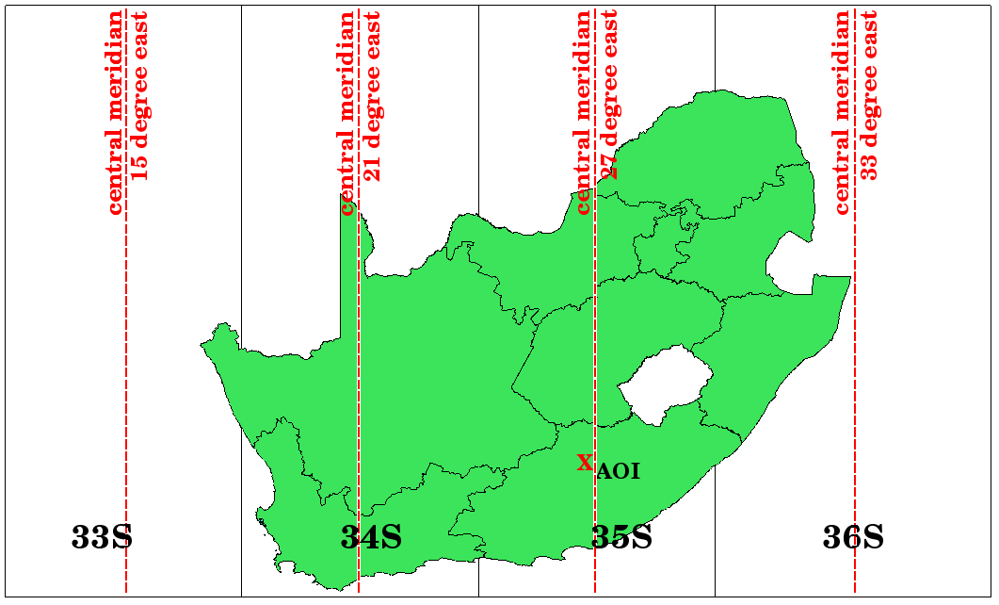
5.1 Aside – Geographic Information Systems
Projected Coordinate Reference System (CRS) – UTM
Botswana 35S

Slide 68
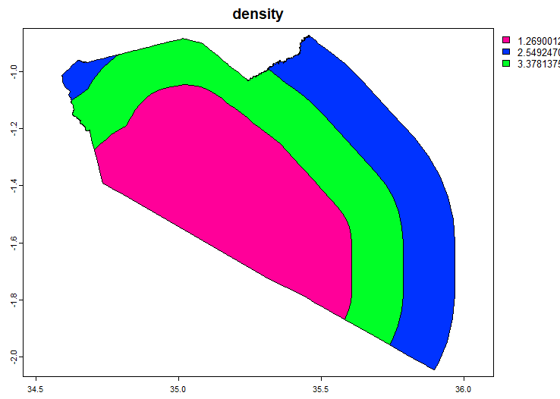
5.3.3.2.2 Cattle density has been calculated for each buffer region
Go back to the point data sampLoc_region and allocate the cattle density to each point

Slide 69
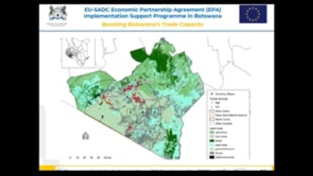
5.6 DEMO - qGIS

Slide 70
5.7 – Create the map in qGIS yourselves
OR
Create a similar map of FMD cases in Botswana (see the Shapefiles folder for a Botswana FMD zone layer)

Slide 71
Theme 5: END

Slide 72
Theme 6: Communicating R Analysis using RMarkdown

Slide 73
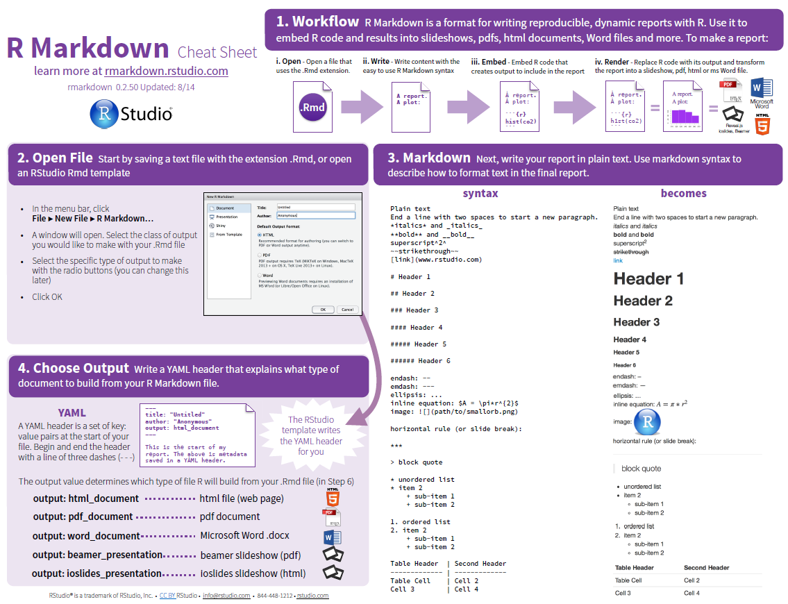
Notes:
Rmarkdown Cheat Sheet HERE

Slide 74
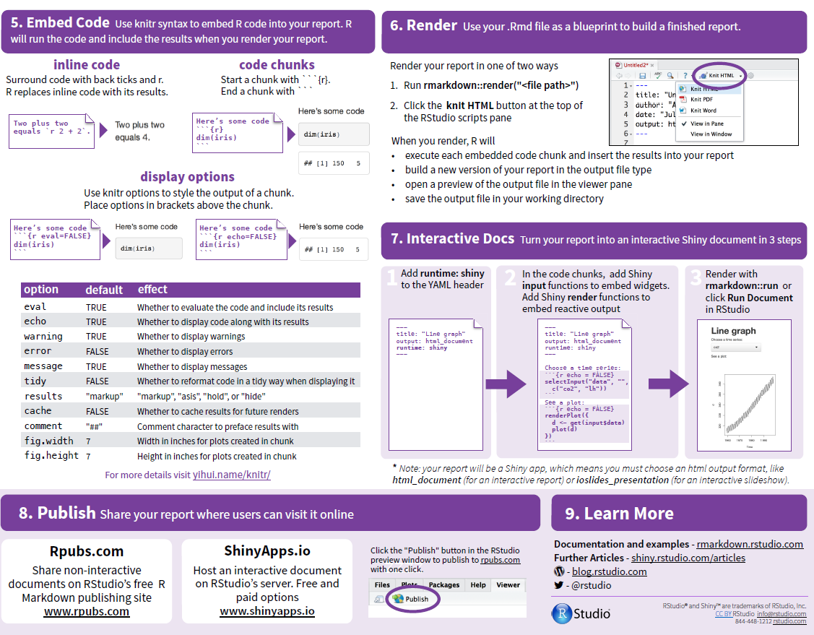
Notes:
Rmarkdown Cheat Sheet HERE

Slide 75
Open 06_RMarkdown.Rmd
Open 06_Analysis.Rmd

Slide 76
Use the existing Rmarkdown document and add a section from any of the other analysis we have done based on the Nthiwa et al. manuscript
OR
Use one of your own datasets and make a basic start to a report

Slide 77
Theme 6: END

Slide 78
Theme 7: Further analysis of diagnostic tests

Slide 79
Diagnostic test evaluation is a complex topic.
Typical issues with non-gold standards
Where gold standards exist then analysis is manageable and pretty much descriptive as sensitivity, specificity and other test characteristics
We have looked at interpreting diagnostic tests in parallel and an series
To further our knowledge we will consider the
Kappa statistic
Descriptive stats on Ct values
Notes:
Rmarkdown Cheat Sheet HERE

Slide 80
KAPPA statistic
Kappa is a measure of agreement beyond the level of agreement expected by chance alone. The observed agreement is the proportion of samples for which both methods (or observers) agree (see ?epiR::epi.kappa)
Can be used to evaluate an opinion as well as a diagnostic test
Flip coin by two different people and establish Kappa

Slide 81
Open 07_Tests.R

Slide 82
Descriptive stats on Ct values
Source of Ct based testing
Discuss

Slide 83
Theme 7: END

Slide 84
Self projects
Evaluate the WAHID FMD data. Make a Rmarkdown document that provides descriptive statistics of the FMD reporting including an Epidemic curve
Using the botswanaFMDControl shapefile establish the average Cattle density within each region in the country
Using the case data establish the average of the average prevalence for each overarching outbreak within each region and plot this as a choropleth map
Create a publishable map in qGIS indicating the underlying cattle density, the FMD control zones, the locations of outbreaks that have been reported to the OIE

Slide 85
References and Sources

Slide 86
https://www.sciencedirect.com/science/article/pii/S0167587719305380?via%3Dihub
https://data.mendeley.com/datasets/8drcnw9y2k/1
Spatial – naturalearthdata.com
OIE WAHID (www.oie.int)
GLW: Gilbert M, G Nicolas, G Cinardi, S Vanwambeke, TP Van Boeckel, GRW Wint, TP Robinson (2018) Global Distribution Data for Cattle, Buffaloes, Horses, Sheep, Goats, Pigs, Chickens and Ducks in 2010. Nature Scientific data, 5:180227. doi: 10.1038/sdata.2018.227
http://geoportal.icpac.net/

Slide 87
epiR Tools for the Analysis of Epidemiological Data – 2022
Charles DiMaggio – an introduction to R for epidemiologists
https://rspatial.org
https://happygitwithr.com/

Slide 88
Thank you
Ke a Leboga

